Slide 1
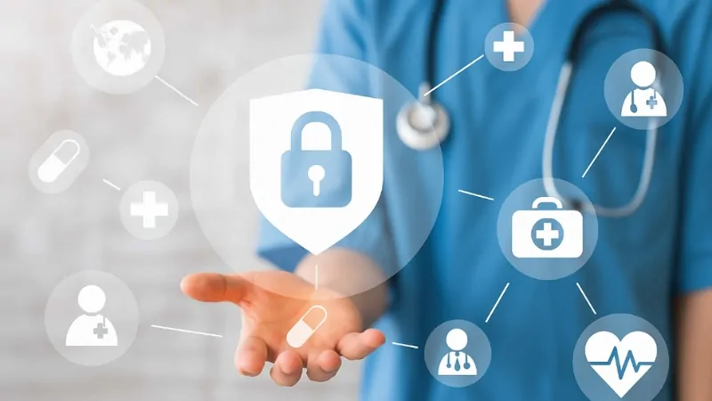
Securing Digital Healthcare: Safeguarding Patient Information
Presented by: Group 12
Saketh Racha - 120201202
Surya Korlepara - 120426032
Bhanu Teja Panguluri - 120193378

Slide 2
Table of Contents
Introduction
Scope and Objectives
Current state analysis
Current Architecture
Recommended Architectural Framework
Recommended Security Approach
Security Mapping Matrix
Investment and Integration Approach
Measurements and Evaluation
Alternative Solutions and Evaluation
Conclusion
References

Slide 3
Introduction
The healthcare infrastructure experienced a ransomware attack, resulting in the compromise of a significant amount of Protected Health Information (PHI) and employee Personally Identifiable Information (PII). Although the ransom has been paid, our objective is to assess the current state of the infrastructure and enhance its overall security posture. *PHI is central to patient care and financial processing; compromise may result in HIPAA violations, reputational loss, and legal liabilities.

Slide 4
Scope and Objectives
Scope
This project seeks to strengthen healthcare security to ensure HIPAA compliance and safeguard patient data against unauthorized access.
Prevent Breaches
Protect patient records from data breaches and unauthorized access.
Mitigate Ransomware
Reduce the likelihood of ransomware attacks against healthcare systems.
Enhance Security Posture
Strengthen the healthcare system’s overall cybersecurity framework.

Slide 5

Current State Analysis
Recent security incidents have highlighted critical vulnerabilities within the healthcare infrastructure:
The lab machines and PHI systems were directly accessible from the internet
The hospital network lacked network segmentation, enabling lateral movement by attackers
No IDS/IPS or SIEM tools were in place to detect threats
Many systems were running outdated Windows 7 operating systems
No MFA was enabled for remote or administrative access
Patient data was stored unencrypted
Staff had limited or no security awareness training, making them highly vulnerable to phishing
A thorough understanding of the current environment is essential to designing and implementing effective security enhancements.

Slide 6
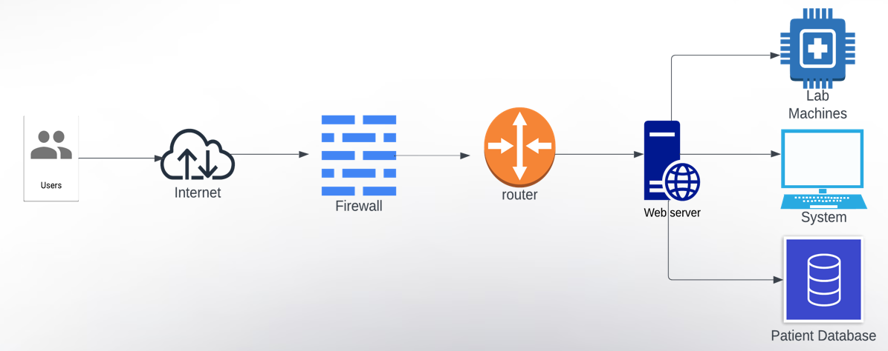
Current Architecture

Slide 7
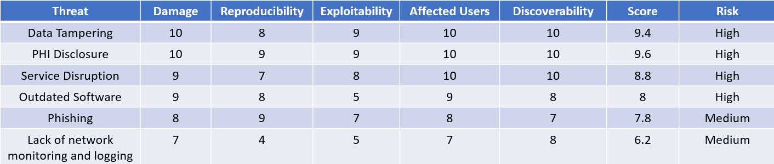
Risk Assessment (DREAD) of Existing Architecture

Slide 8
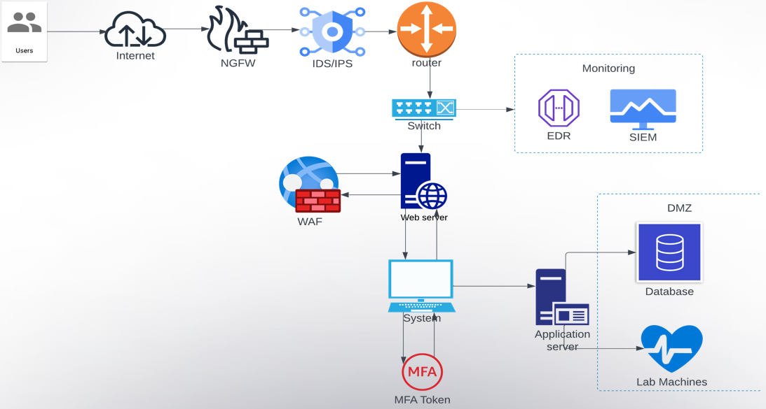
Recommended Architectural Framework

Slide 9

Recommended Security Approach
Deploy advanced Endpoint Detection and Response (EDR) tools to protect against malware and advanced threats
Architect the system in alignment with HIPAA compliance standards
Apply network segmentation to minimize the attack surface and contain potential breaches
Implement data encryption to safeguard sensitive patient information
Establish strong access control and identity management systems to protect PHI
Integrate Intrusion Detection and Prevention Systems (IDS/IPS) for real-time threat monitoring and response
Utilize Security Information and Event Management (SIEM) for centralized log analysis and incident detection
Set up a Demilitarized Zone (DMZ) to isolate critical systems from public access
Enforce Multi-Factor Authentication (MFA) across applicable systems for enhanced access security
Adopt a patch management solution to ensure timely updates and remediation of software vulnerabilities
Leverage secure communication and collaboration tools to protect sensitive data in transit
Conduct regular security awareness training to educate employees on best practices and threat prevention

Slide 10
Investment and Integration Approach
Control | Estimated Cost | Key Vendors | Integration Method
Endpoint Protection (EDR) | $50,000 | Symantec, McAfee | Internal IT + Vendor Setup
Data Encryption | $30,000 | Sophos, Trend Micro | Specialized Professionals
IAM | $40,000 | Okta, Microsoft AD | In-house IT + Vendor Guidance
IDS/IPS | $60,000 | Cisco, Palo Alto | Certified Engineers + Monitoring
Costs assume coverage for ~100 devices/users. Licensing models scaled accordingly

Slide 11
Investment and Integration Approach
Control | Estimated Cost | Key Vendors | Integration Method
SIEM | $80,000 | Splunk, IBM QRadar | External Setup + Maintenance
Patch Management | $30,000 | Ivanti, SolarWinds | Internal IT + Vendor Support
Secure Collaboration | $20,000 | MS Teams, Slack | IT Setup + Encryption Enhancements
Remote Monitoring (RMM) | $50,000 | ConnectWise, Kaseya | Vendor-Managed + Tech Setup
Costs assume coverage for ~100 devices/users. Licensing models scaled accordingly

Slide 12
Security Mapping Matrix
Asset | Threat | Control/Solution | Estimated Cost
Patient Health Information (PHI) | Data breaches, unencrypted storage | Data Encryption (at rest and in transit), IAM (Role-Based), MFA | $30,000 (Encryption) $40,000 (IAM)Included in others (MFA)
PHI Systems & Lab Machines | Ransomware, Lateral Movement | EDR, Network Segmentation, Patch Management | $50,000 (EDR)$30,000 (Patch Mgmt)
Hospital Network Infrastructure | No visibility, lateral movement | IDS/IPS, SIEM, DMZ | $60,000 (IDS/IPS)$80,000 (SIEM)
Employee Accounts | Phishing, Credential Theft | Security Awareness Training, IAM, MFA | Included (MFA)Minimal for training$40,000 (IAM)
Communication Channels | Data leakage, man-in-the-middle attacks, insecure file sharing | Encrypted Collaboration Tools | $20,000
Remote Access Systems | Unauthorized remote access, credential reuse, lack of MFA | MFA, IAM, Secure RMM | $50,000 (RMM)
Endpoint Devices | Malware, outdated software | EDR, Patch Management | $50,000 (EDR)$30,000 (Patch Mgmt)

Slide 13
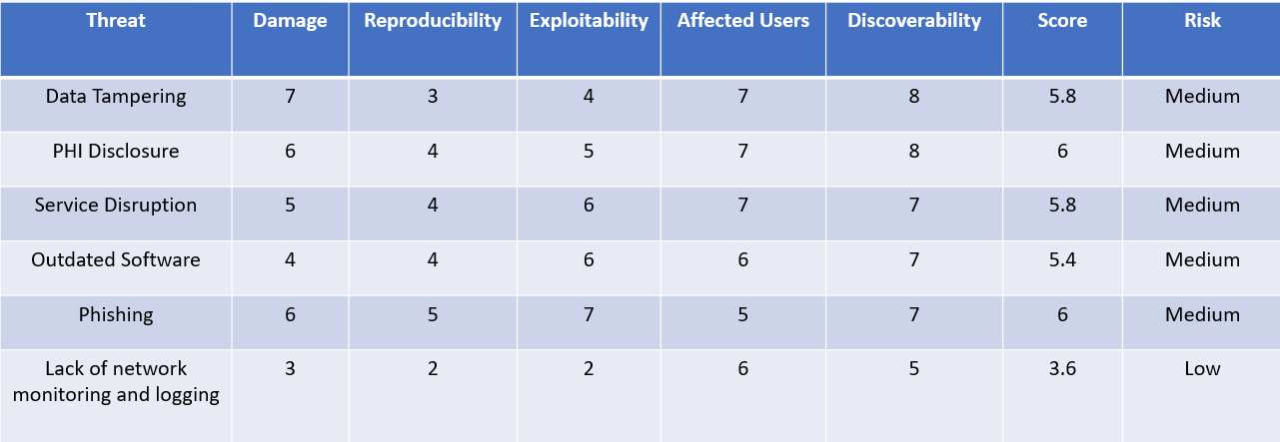
Risk Assessment (DREAD) of New Architecture

Slide 14

Measurements and Evaluation
Key Performance Indicators for Measuring Effectiveness
To assess the effectiveness of the implemented security measures, key performance indicators (KPIs) will be tracked. These will include metrics such as the number of detected and mitigated security incidents, adherence to regulatory standards like HIPAA, and the decline in unauthorized access attempts.
2. Continuous Monitoring
Security Information and Event Management (SIEM) tools such as Splunk, IBM QRadar, or Wazuh will enable real-time monitoring, log correlation, and alerting. Customized dashboards will provide visibility into threat activity and system health, ensuring quick response to incidents and reducing the risk of prolonged exposure.
3. Threat Adaptation
Through continuous performance monitoring and incident analysis, the healthcare organization can pinpoint areas for enhancement and adapt its security strategy to address emerging threats. This agile methodology ensures sustained effectiveness of the implemented security measures over time.

Slide 15
Alternative Solutions and Evaluation
In assessing the proposed security solution, it is essential to explore alternative approaches and vendor options. Key factors including cost, scalability, and effectiveness must be thoroughly evaluated to ensure the chosen solution aligns with the healthcare organization’s unique requirements and limitations.
Alternative Security Solutions
Open-source options like Wazuh (SIEM) or JumpCloud (IAM) can reduce costs but may require more internal expertise. Commercial tools like Splunk and Okta offer better support and scalability.
Implementation Strategies
A phased rollout starting with high-risk systems (e.g., labs, admin PCs) can minimize disruption. Pilot testing tools like EDR or secure communication platforms helps evaluate integration and user adoption.
Trade-off Evaluation
Lower-cost tools can reduce initial investment but may increase setup time and maintenance effort. Commercial solutions offer faster deployment and better compliance support but at a higher price. Choosing the right mix depends on available resources, staff expertise, and long-term security goals.

Slide 16

Conclusion
Recent security breaches highlight the urgent need for strong security measures in the healthcare sector to protect patient data and uphold public trust. Prioritizing cybersecurity and investing in comprehensive protection strategies is essential for mitigating risks and ensuring patient privacy.

Slide 17
References
Cybersecurity in Healthcare: Protecting Patient Data and Maintaining Trust – Journal of Healthcare Information Management
Mitigating Ransomware Attacks in the Healthcare Sector
– NIST Cybersecurity Practice Guide
HIPAA Security Rule Compliance Checklist
– U.S. Department of Health & Human Services
Best Practices for Securing Connected Medical Devices
– Healthcare Information and Management Systems Society (HIMSS)
Emerging Cyber Threats in Healthcare: Trends and Mitigation Strategies
– Gartner Research Report

